Slide 1

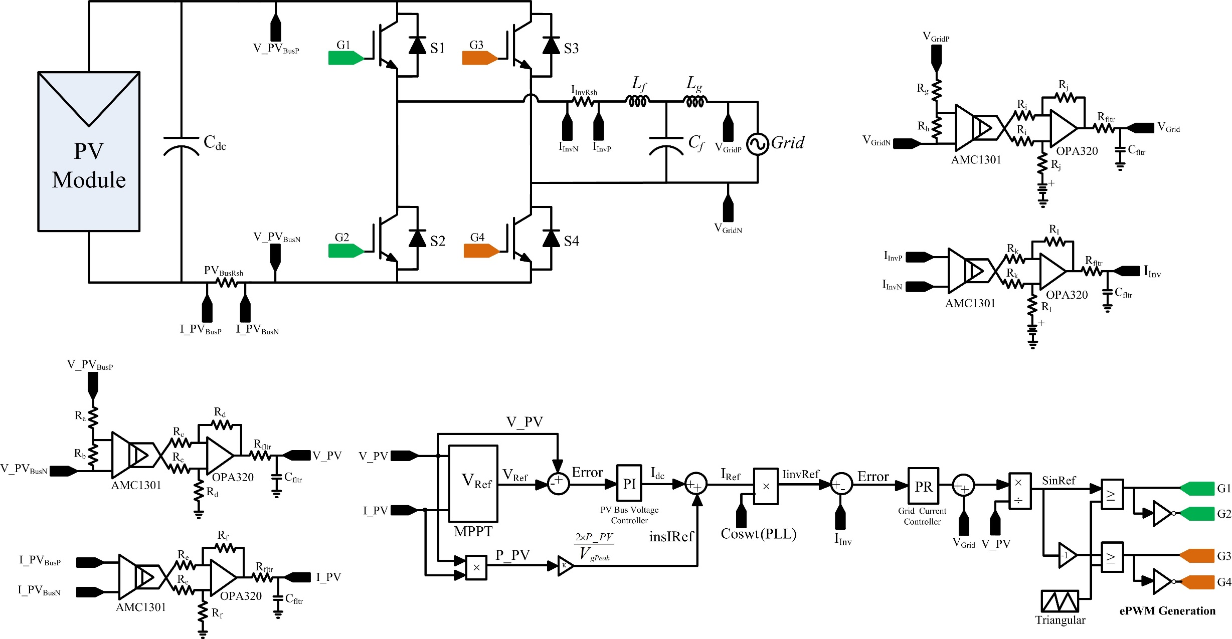

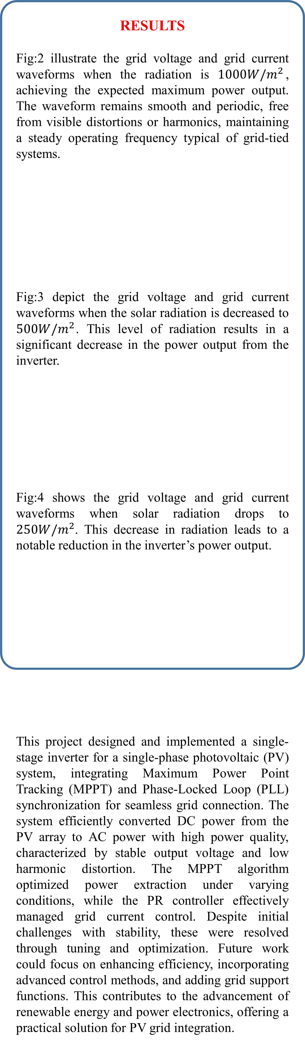
Topic
“Design and Control of Single-Stage Inverter for Single-Phase PV with MPPT Algorithm”
Name: ANTU ROY
Name of Guide: Dr. Nikhil Sasidharan
Department of Electrical Engineering
National Institute of Technology Calicut, Kozhikode
ABSTRACT
This project presents a single-stage inverter design for grid-connected photovoltaic (PV) systems. The system integrates a Perturb and Observe (P&O) MPPT algorithm for maximum power extraction, Proportional-Integral (PI) controller for PV bus voltage control, a Proportional-Resonant (PR) controller for precise grid current control, and Phase-Locked Loop (PLL) synchronization for seamless grid connection. A unipolar sine PWM technique and LCL filter reduce harmonic distortion and improve output power quality. Simulations confirm stable operation under varying solar conditions, offering an efficient and cost-effective solution for single-phase grid-connected PV applications.
METHODOLOGY
The methodology began with the design and modeling of the photovoltaic (PV) system, specifically selecting a single-stage inverter topology that employs a unipolar sine pulse-width modulation (PWM) technique for efficient DC-to-AC conversion. The control strategy was formulated by implementing the perturb and observe (P&O) maximum power point tracking (MPPT) algorithm to ensure maximum power extraction from the PV array. A proportional-integral (PI) controller was designed for regulating the PV bus voltage, while a proportional-resonant (PR) controller was developed for precise current control and seamless synchronization with the grid.
To enhance grid synchronization, a phase-locked loop (PLL) was integrated, utilizing a second-order generalized integrator (SOGI) for accurate phase detection. An LCL filter was also designed to mitigate harmonic distortion, and unipolar PWM was applied to further reduce system distortion.
The entire system is simulated using MATLAB/Simulink and PLECS to evaluate performance under varying conditions, such as fluctuations in solar irradiance and temperature. Performance metrics, including system efficiency, power quality, and grid stability, were thoroughly analyzed, leading to the optimization of key parameters.
RESULTS
Fig:2 illustrate the grid voltage and grid current waveforms when the radiation is ${1000W/m}^{2}$, achieving the expected maximum power output. The waveform remains smooth and periodic, free from visible distortions or harmonics, maintaining a steady operating frequency typical of grid-tied systems.
Fig:3 depict the grid voltage and grid current waveforms when the solar radiation is decreased to ${500W/m}^{2}$. This level of radiation results in a significant decrease in the power output from the inverter.
Fig:4 shows the grid voltage and grid current waveforms when solar radiation drops to ${250W/m}^{2}$. This decrease in radiation leads to a notable reduction in the inverter’s power output.
This project designed and implemented a single-stage inverter for a single-phase photovoltaic (PV) system, integrating Maximum Power Point Tracking (MPPT) and Phase-Locked Loop (PLL) synchronization for seamless grid connection. The system efficiently converted DC power from the PV array to AC power with high power quality, characterized by stable output voltage and low harmonic distortion. The MPPT algorithm optimized power extraction under varying conditions, while the PR controller effectively managed grid current control. Despite initial challenges with stability, these were resolved through tuning and optimization. Future work could focus on enhancing efficiency, incorporating advanced control methods, and adding grid support functions. This contributes to the advancement of renewable energy and power electronics, offering a practical solution for PV grid integration.
Fig.2 Grid Voltage and Grid Current waveforms at ${1000W/m}^{2}$
INTRODUCTION
As the demand for renewable energy grows, photovoltaic (PV) systems have become a promising solution for clean power generation. This project focuses on developing a single-stage inverter for grid-connected PV applications, aiming to simplify the system architecture while maintaining high performance.
The system is equipped with a Perturb and Observe (P&O) MPPT algorithm, which efficiently extracts maximum power from the solar panels, even under varying environmental conditions. A Proportional-Integral (PI) controller regulates the PV bus voltage, ensuring the system's stability. Additionally, a Proportional-Resonant (PR) controller is employed for precise current control, allowing the inverter to synchronize seamlessly with the grid.
A Phase-Locked Loop (PLL) ensures accurate phase synchronization with the grid, and the use of a unipolar sine PWM technique, combined with an LCL filter, reduces harmonic distortion. These features contribute to high power quality and reliable operation, making the system a cost-effective solution for single-phase grid-connected PV systems.
Fig.3 Grid Voltage and Grid Current waveforms at ${500W/m}^{2}$
EQUATIONS USED
The Transfer Functions of OSG Based PLL is given by:
$H_{d}\left(s\right)$= $\frac{k_{ωn}s}{s^{2}+ k_{ωn}s+ ω_{n}^{2}}$ …………(1)
$H_{q}\left(s\right)$ = $\frac{k_{ω_{n}^{2}}}{s^{2}+ k_{ωn}s+ ω_{n}^{2}}$ …………(2)
Where
$H_{d}(s)$ is the Transfer Function of the Direct Axis
$H_{q}(s)$ is the Transfer Function of the Quadrature Axis
$k_{ωn}$ is the Damping Factor
$ωn$ is the Natural Frequency
s is the Complex Frequency Variable
The transfer function of the PR controller is given by:
$G_{PR}\left(s\right)=k_{p}+ \frac{K_{p}s}{s^{2}+ ω^{2}}$…………(3)
$G_{PR}\left(s\right)$ is the Proportional-Resonant Controller Transfer Function
$k_{p}$ is the Proportional Gain
$k_{p}$ is the Integral Gain
$ω$ is the Resonant Pole Frequency in Radians
Fig.4 Grid Voltage and Grid Current waveforms at ${250W/m}^{2}$
CONCLUSIONS
GENERAL BLOCK DIAGRAM OF THE SCHEME
Fig.1 Control Strategy of Single-Phase PV Solar Inverter

